Slide 1



Multi-Gnss environment: Current Status and Development Perspectives in Vietnam
WORKSHOP ON VIETNAMESE – GERMAN TECHNOLOGY COOPERATION AND CULTURAL EXCHANGE
A/Prof. TA HAI TUNG
NAVIS Centre, HUST, Vietnam
Hanoi, June 9th 2016

Slide 2
Contents
Current Status of GNSSes in the world
GNSS Applications and Deployments in Vietnam
Multi-GNSS: Opportunities and Challenges for Vietnam
Conclusions

Slide 3


(x,y,z,dt)
(x,y,z)
3

Slide 4
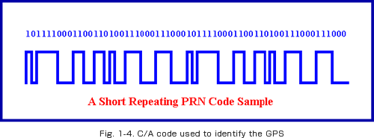
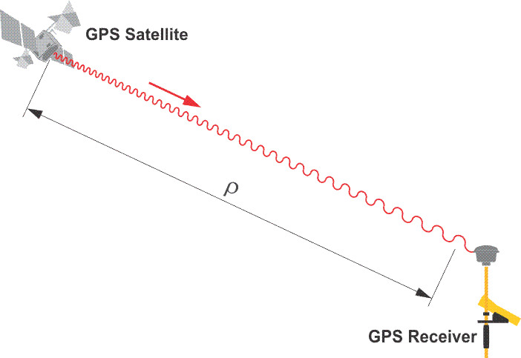
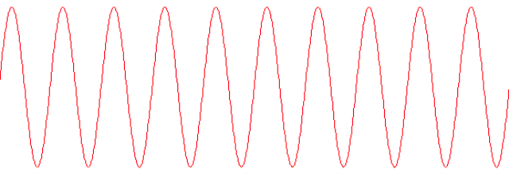
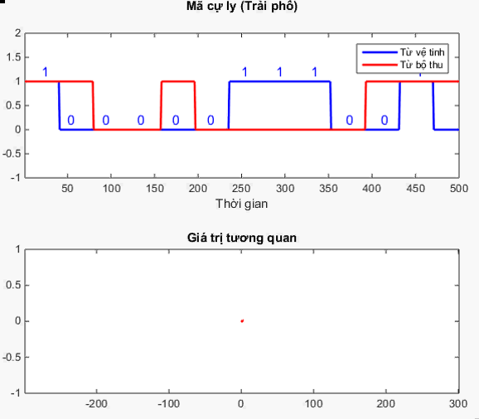
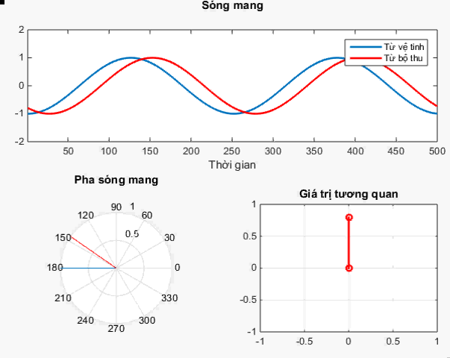
Carrier Power
Navigation data
Ranging code (C/A)
Carrier
Initial phase
1.023 MHz
How to measure the distance?
1575.42 MHz

Slide 5
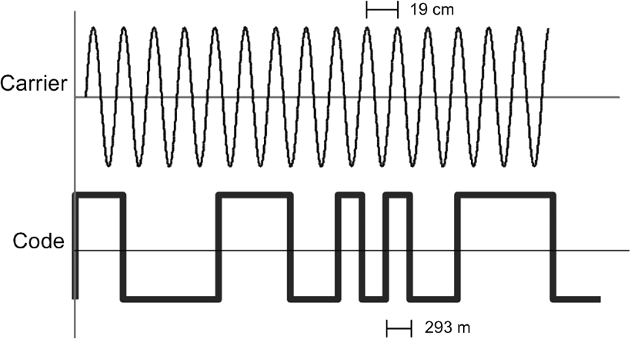

mm, cm, dm level of accuracy
Carrier
Ranging code
m level of accuracy

Slide 6


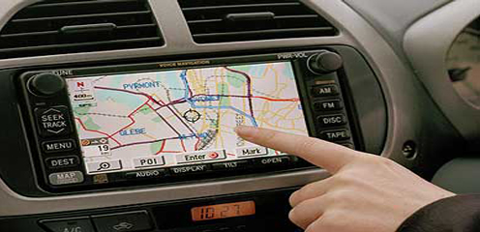
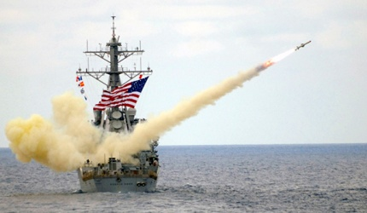



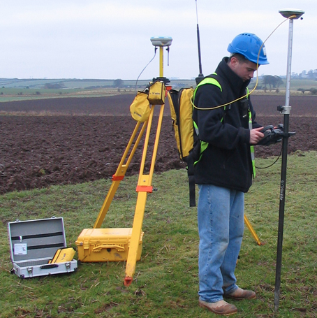
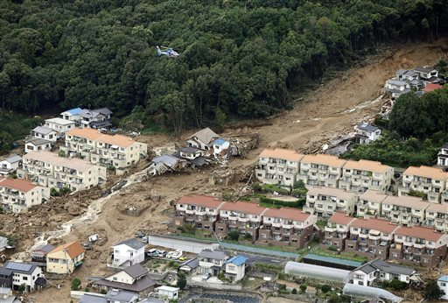
Applications of GNSS
The US Government thinks...
Ordinary users think…
In fact, many important applications…
Future…

Slide 7

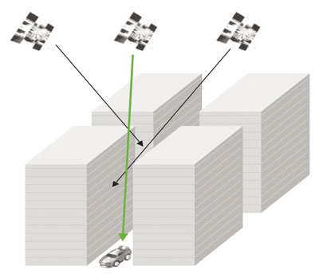
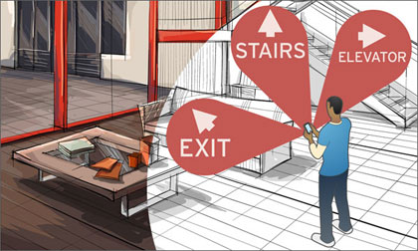
Modern Satellite Navigation Systems
“GPS is working so well, why we need other GNSSes?”
Technical reasons:
GPS is 40-year-old system, designed in 1970s;
Several GPS satellites continue to operate much longer than their designed life span, e.g. the satellite PRN 32, launched 26/11/1990
New application demands:
Higher accuracy, availability, and reliability
Positioning in harsh environments (indoor, urban canyon…).

Slide 8
Economical reasons:
Global market for GNSS products and services of more than 100 billion Euros per year
(Source: GNSS Application Market Opportunities, European GNSS Agency, 11/2014

Slide 9
Political reasons:
GPS is a military system ➔ civil services are provided without any guarantees;
Independent systems for key players in the world (USA, EU, Russia, Chinese, India…)

Slide 10

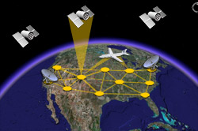
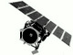
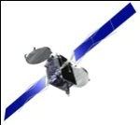





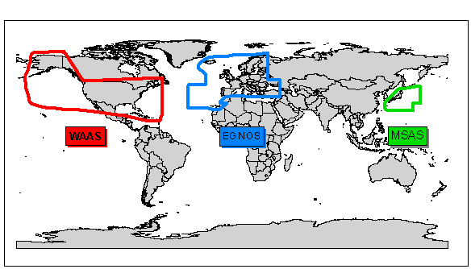




Modern Satellite Navigation Systems
Global Navigation Satellite Systems (GNSS)
RegionalNSS
QZSS 2018 (1/4)
IRNSS
2016 (3/7)
Augmentation Systems
GPS: 1995 (32)
GLONASS: 2011 (28)
Galileo: 2019 (6/30)
Beidou: 2020 (14/35)
2020:~ 140 satellites for navigational purposes

Slide 11
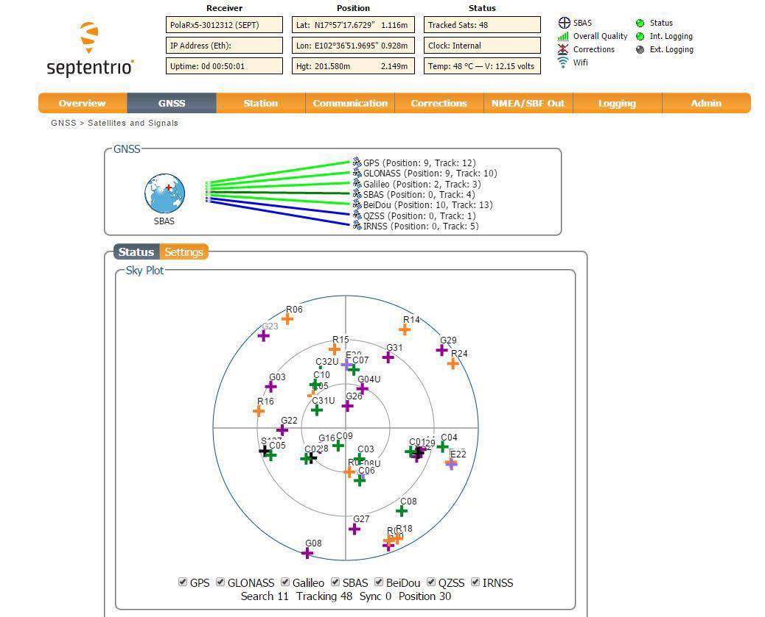

Slide 12
“Compatibility / Interoperability”?
“Compatibility refers to the ability of global and regional navigation satellite systems and augmentations to be used separately or together without causing unacceptable interference and/or other harm to an individual system and/or service.”
(on Radio Frequency Compatility, Spectral Separation)
vs.
“Interoperability refers to the ability of global and regional navigation satellite systems and augmentations and the services they provide to be used together to provide better capabilities at the user level than would be achieved by relying solely on the open signals of one system.” (on Reference / Time frames, common carrier frequencies, signal in space)
The systems should at least achieve “Compatibility”,
aiming at “Interoperability”

Slide 13
Bilateral/Multilateral Negotiations and Agreements
Bilateral:
1998: Agreement between USA and Japan for GNSS cooperation, so that GPS and QZSS are “compatible” and “highly interoperable”.
2003: Agreement between EU and China on regular updates on compatibility between Galileo and Beidou systems
2004: Milestone cooperation agreement between EU and USA, resulted in the first “interoperability” signal Galileo E1 OS.
Since 2005: Negotiation between USA and Russia on cooperation in GNSS technology, establishing working groups on system compatibility.
2007: Agreement between USA and India, aiming at compatibility between GPS and IRNSS
2014: First bilateral meeting between USA and China on compatibility between GPS and Beidou.
Besides, EU is negotiating with China, India, Japan
Multilateral:
ICG (International Committee on Global Navigation Satellite Systems)
APEC (Asia-Pacific Economic Cooperation) GIT (GNSS Implementation Team)

Slide 14
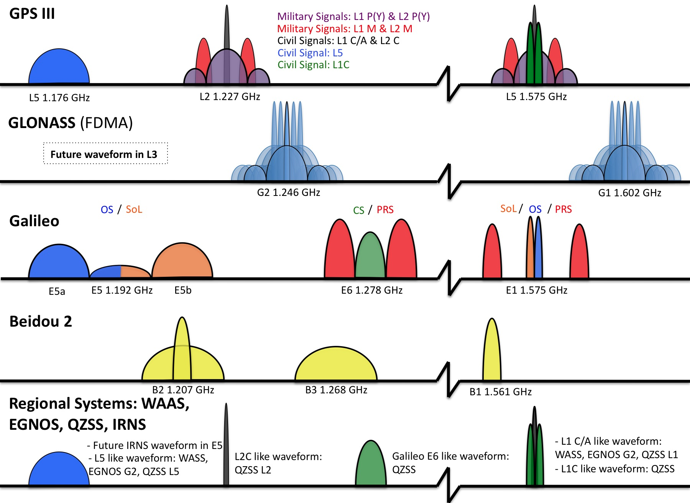
Opportunities from Multi-GNSS environment
More signals, more services => more options
L1 C/A: 1st civil signal
L1

Slide 15
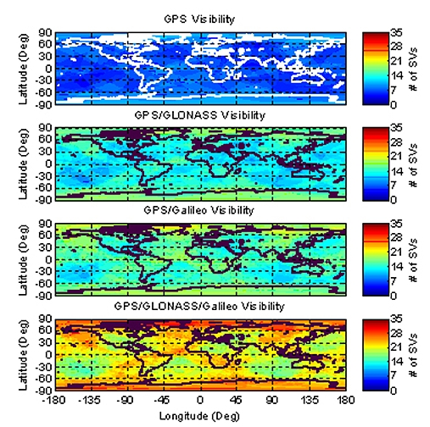
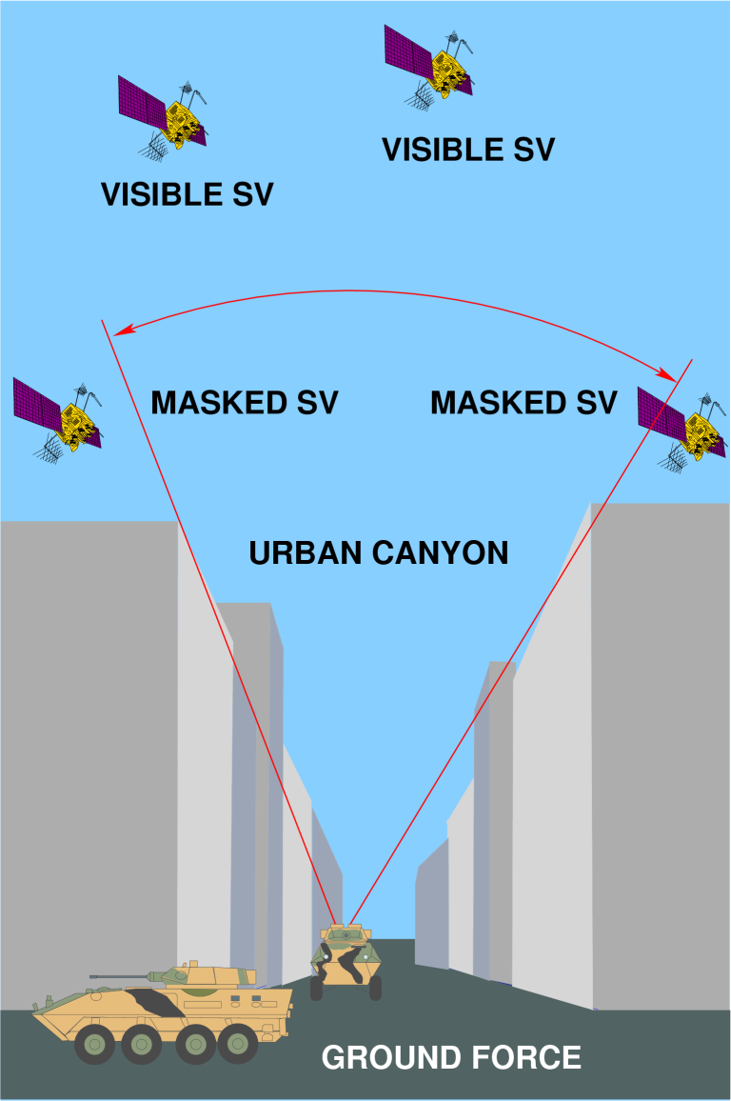
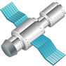
Increase in availability and coverage:
Urban canyon problem

Slide 16
Increase in availability and accuracy:
Source: multiGNSS.asia

Slide 17
Increase in availability and accuracy:
Source: multiGNSS.asia

Slide 18
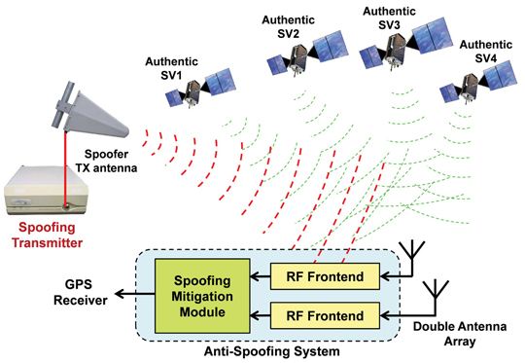

More robust and reliable services:
Reliable services: Integrity information is provided by SBAS or GNSSes;
Robustness positioning:
New advanced signals (more difficult to be jammed and spoofed);
The redundancy of multi-systems and multi-bands; and the supports from aiding entities (including non-satellite based positioning systems, and secured military GNSS receivers).

Slide 19
GNSS Applications in Vietnam
In geodesy, mapping
Since 1989: Department of Survey and Mapping Vietnam (DOSM) utilized 3 units of Trimble 4000-ST for setting up coordination network and cadastral map
12/2004: complete the national cadastral map (level III), and the basic topographic maps 1/50.000, in National Coordination system VN-2000
2015: DOSM started the project of “Building the network of GNSS stations in Vietnam” aims at:
Bulding the first Continuous Operating Reference Stations (CORS) network in Vietnam
Providing Network Realtime Kinematic (RTK) services (2-4 cm accuracy); and post-processing positioning services (mm accuracy) in Vietnam
Supporting other applications and activities, such as: environment monitoring (landslide, tsunami, space weather…), transportation, precise agriculture, national security and defense…

Slide 20
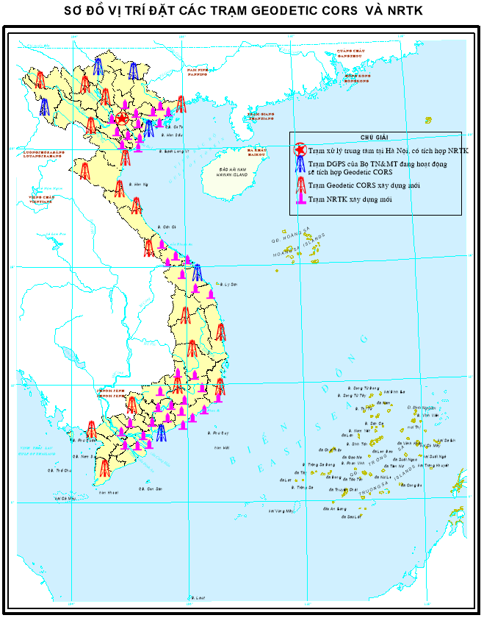
165 stations are needed for the whole country.
In the 1st phase (2016-2019), the network will have:
24 Geodetic stations (core)
41 NRTK stations (50-80 km each)
1 data and control centre at Hanoi
Currently: existing 10 DGPS stations nationwide
MoNRE: 6 stations (Quang Nam, Do Son, Vung Tau, Dien Bien, Ha Giang, Cao Bang)
MoD: 4 stations (Mong Cai, Da Nang, Phu Quoc, Truong Sa)

Slide 21
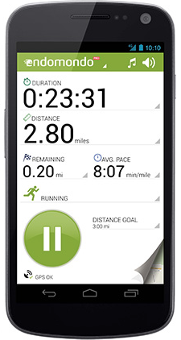
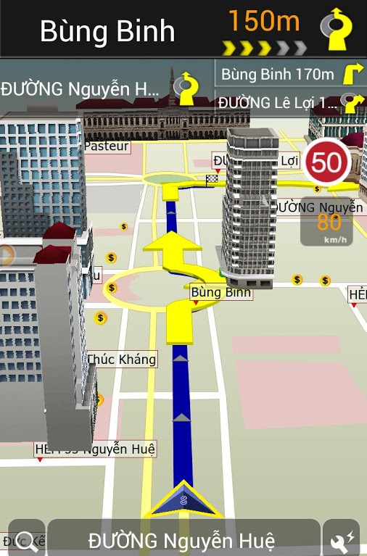
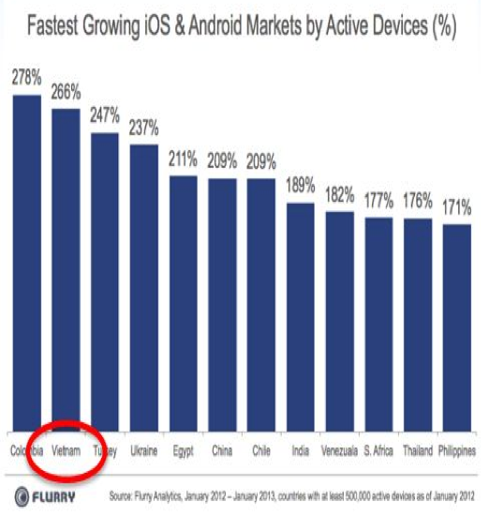
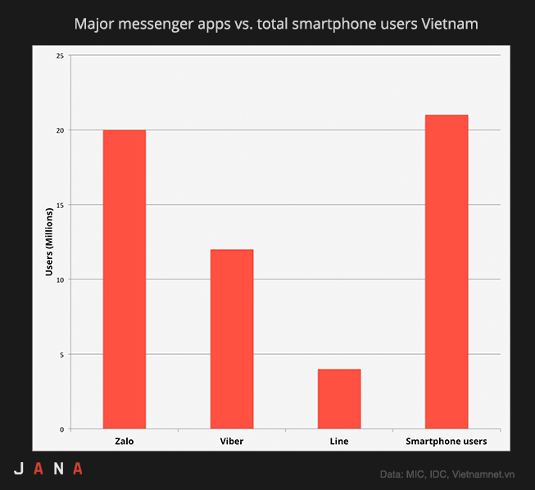
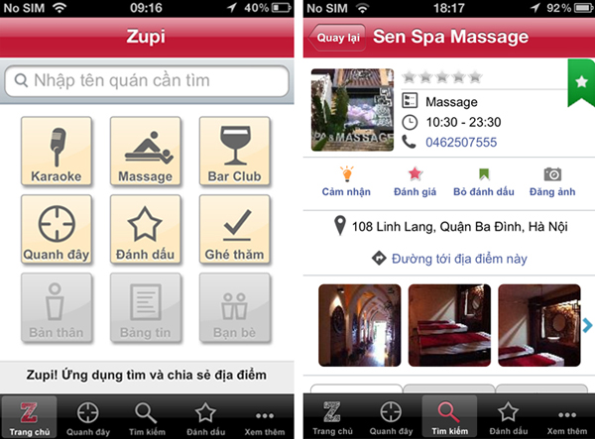
The smartphone boom

Slide 22
In vehicle tracking:
2009: Vietnamese Government enacted Decree 91/2009/NĐ-CP later on replaced by Decree 86/2014/NĐ-CP requires: “All vehicles used for transport business have to be equipped with tracking devices (including passengers and goods)”
2014: Ministry of Transportation (MoT) enacted Standard QCNV-31:2014 on the trackers
2013: MoT enacted Circular 23/2013/TT-BGTVT (replaced by Circular 09/2015/TT-BGTVT) requiring vehicles to transmit tracking data to Center of Tracking Data Monitoring (CTDM), Directorate for Roads of Vietnam (DRVN)
12/2013: MoT enacted Circulars 55/2013/TT-BGTVT detailing fine regulations for speed violation, basing on tracking data sent to the Center

Slide 23
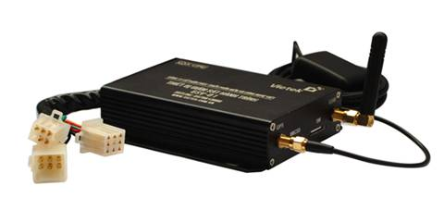
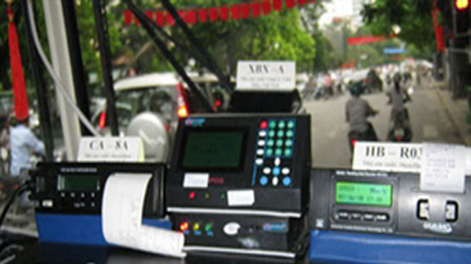

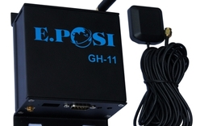

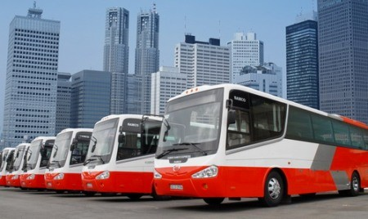

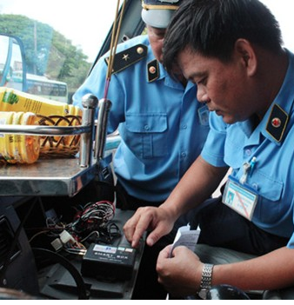
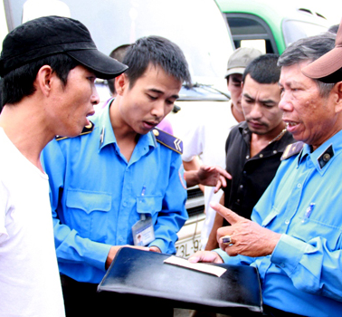
51 companies have conformance devices
2 import companies (2014)
82.816 vehicles
(30/11/2014)
Multiple implementation issues:
Black boxes quality;
Owner’s awareness;
Regulations

Slide 24
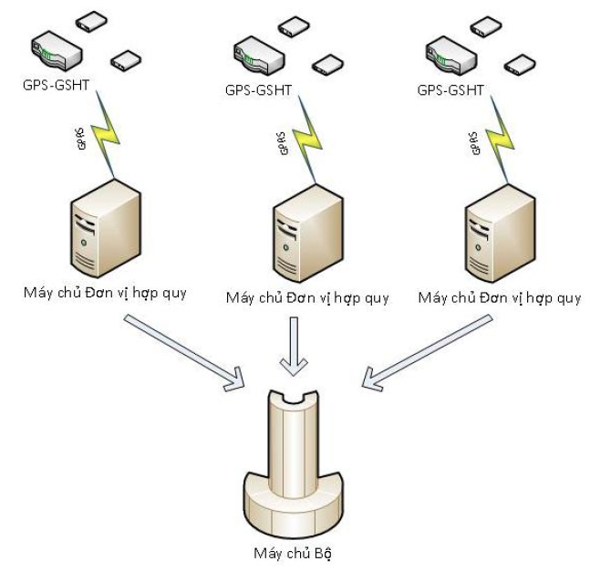


Company Monitoring Server
Company Monitoring Server
Company Monitoring Server
Digital map server,
at IT Center, MoT
Tracker Monitoring Center,
at DRVN

Slide 25
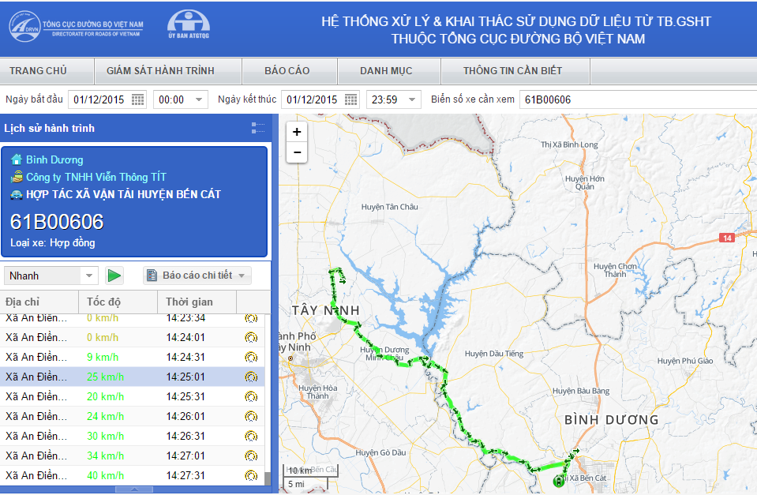
According to implementation report of DRVN (4/2016): 182.000 vehicles transmitted
An in 2018: 1.5 million vehicles

Slide 26
Report on the statistics of speed violations by province: Results of data analysis in 10/2015 (the 10 highest provinces)
The number of speed violations per 1000 km decreased dramatically (from 10,3 times/1000 km in 5/2014; to 5,1 times/1000 km in 2/2015, to 0.26 times/1000 km in 10/2015 corresponding to the decrease of 98% in comparison with the beginning point when the system was operated)
Since 5/2014: treating violations with the total number of handled vehicles of 1.505 (Recovering 1.019 car badges, recovering the bus line operation permits of 382 vehicles in 1 month, refusing to issue 104 car badges) (according to the report of The Directorate for Roads of Vietnam, 3/2015).
No | Province | 10/2015 |  | Compare to 09/2015 |  | Accumulating for 10 months
 |  | Numbers of violations | Numbers of violations /1000 km | Numbers of violations | Numbers of violations /1000 km | Total numbers of violations | Total numbers of violations /1000 km
1 | Kon Tum | 5.427 | 2,83 | 3.804 | 1,35 | 17.996 | 1,55
2 | Gia Lai | 6.143 | 2,79 | 3.027 | 1,11 | 114.084 | 6,30
3 | Tây Ninh | 11.060 | 2,74 | 10.746 | 2,64 | 134.288 | 3,81
4 | Sóc Trăng | 3.816 | 1,93 | -2.073 | -1,62 | 67.812 | 1,74
5 | Quảng Trị | 1.379 | 1,61 | 449 | 0,18 | 44.065 | 3,73
6 | Bình Phước | 2.667 | 1,58 | 2.398 | 1,39 | 199.372 | 7,90
7 | Hậu Giang | 2.715 | 1,49 | -2.099 | -1,93 | 50.722 | 2,98
8 | Bà Rịa-Vũng Tàu | 11.391 | 1,35 | 6.335 | 0,59 | 509.449 | 8,95
9 | Bình Định | 8.899 | 1,29 | -4.096 | -1,30 | 243.013 | 5,21
10 | Ninh Thuận | 2.596 | 1,22 | -2.638 | -2,13 | 102.757 | 6,98

Slide 27
Project REMON – Real-time Monitoring of Urban Transport
Project partners
Transport Development and Strategy Institute (TDSI), Ministry of Transport of Vietnam
Institute of Transport Planning and Management, Urban Transport Planning and Management Sector, University of Transport and Communication (UTC)
Vietnamese-German Transport Research Centre (VGTRC), Vietnamese-German University,
Institute for International Urban Research, International Academy Berlin for Innovative Pedagogy, Psychology and Economy gGmbh (INA)
Optical Sensor Systems at Institute of Robotics and Mechatronics, German Aerospace Center (DLR)
Remote Sensing and Geoinformatics, Institute of Geographical Sciences, Free University Berlin
Chair od Transport Planning and Traffic Engineering (FGVV), Technical University Darmstadt
AS&P - Albert Speer & Partner GmbH
Delphi IMM GmbH
WWL Umweltplanung und Geoinformatik GbR

Slide 28
Applying “Big Data” problem, with input is the data from GPS/Mobile phone
Data source
Server
Output

Slide 29
Urban traffic development model (Berlin)
Online map showing real-time traffic
Intersection Pham Van Dong / Xuan Thuy / Pham Hung / Ho Tung Mau
(Cau Giay – Hanoi)
Tuesday, 12:00 pm
Wednesday, 8:00 am

Slide 30
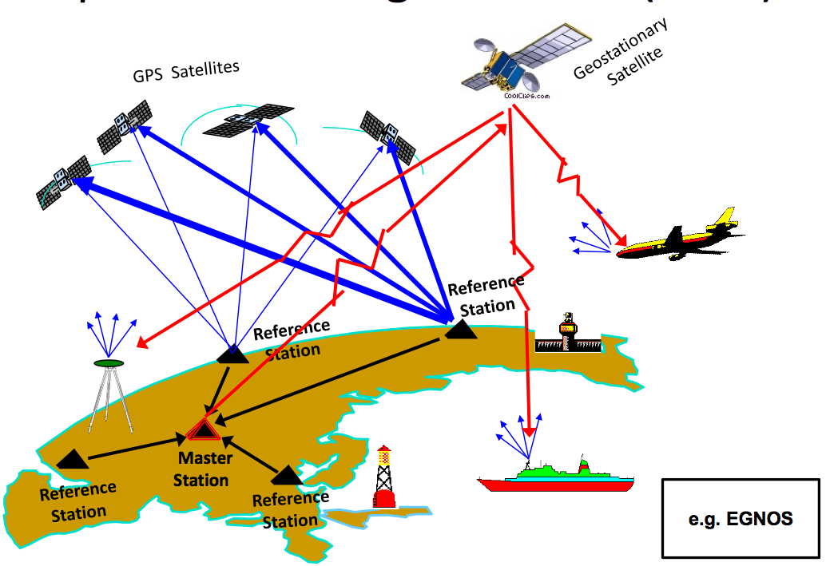
GNSS Challenges for Vietnam
Lack of positioning infrastructure:
Do NOT have our own satellite navigation systems (at least in near future)
Do NOT have enough terrestrial positioning infrastructure (10 D-GPS stations)

Slide 31
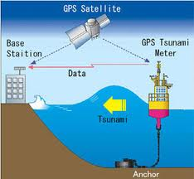

Lack of research on core technologies of satellite navigation
Design the receivers (multi-GNSS, multi-channels,…), precise positioning (technology, infrastructure), anti-jamming, anti-spoofing…
Limited awareness on diverse satellite navigation applications:
Smart Cities (ITS, “green, smart” energy…), precise agriculture, remote sensing using GNSS signals, tsunami warning …

Slide 32
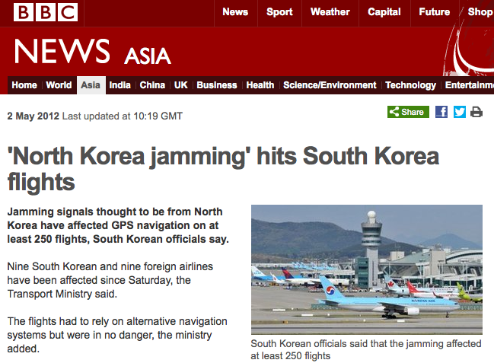
Limited awareness, also actions on security of positioning/navigation (anti-jamming, anti-spoofing, interference mitigation):

Slide 33
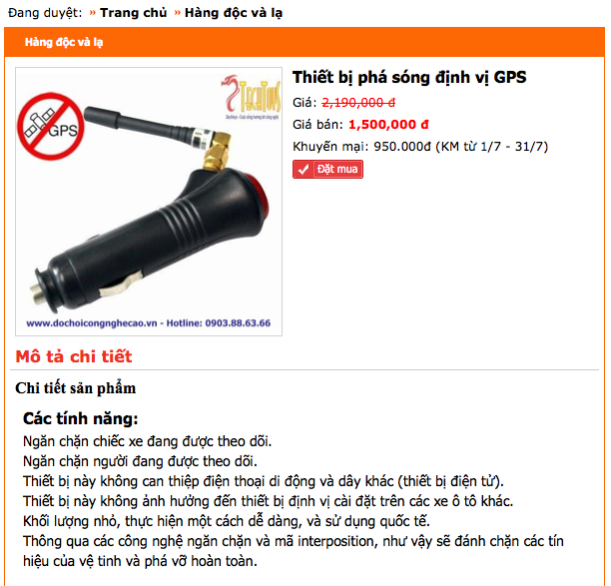
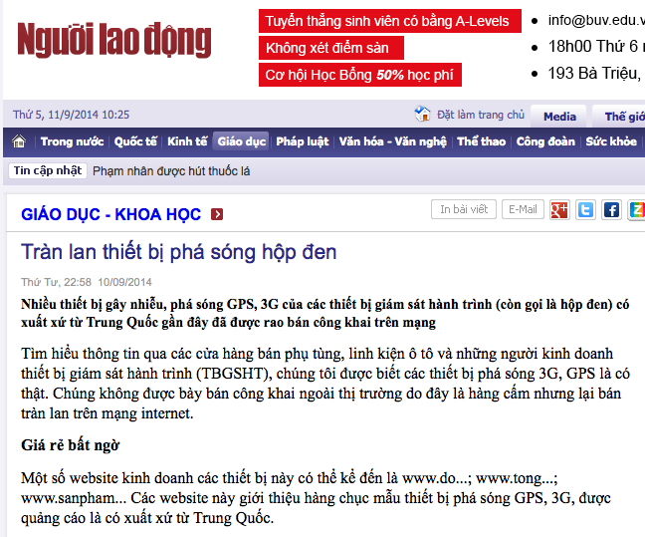

Slide 34
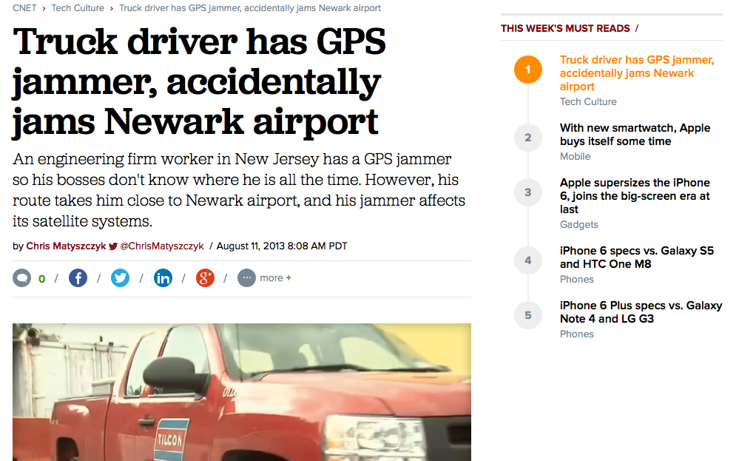
As the New Jersey Star-Ledger reported, the FCC explained: "The signals emanating from the vehicle were blocking the reception of GPS signals used by the air traffic control system.” So Bojczak was fined $31,875 on Friday. And, yes, he was also fired for his misdirection.

Slide 35
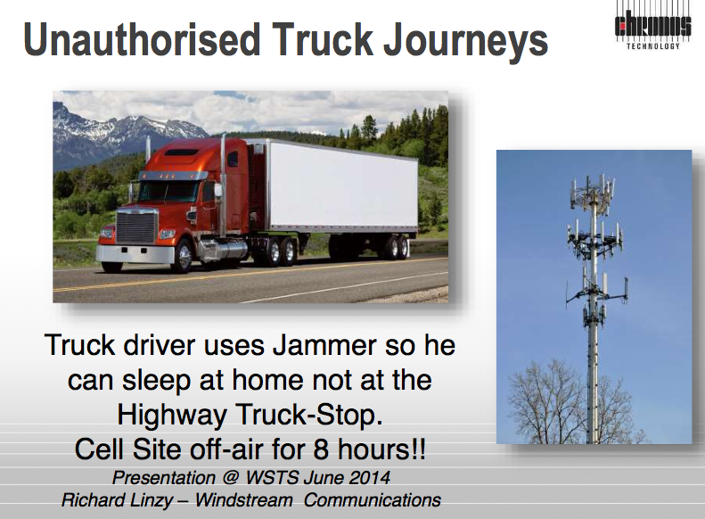

Slide 36



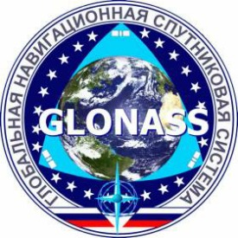

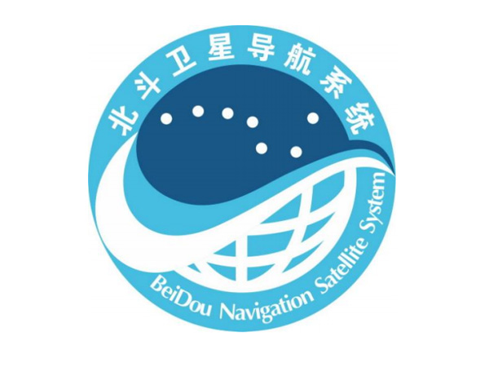
Not yet enacted guidelines, regulations on the use of GNSS (especially in the fields related to government agencies and national security and defense)

Slide 37
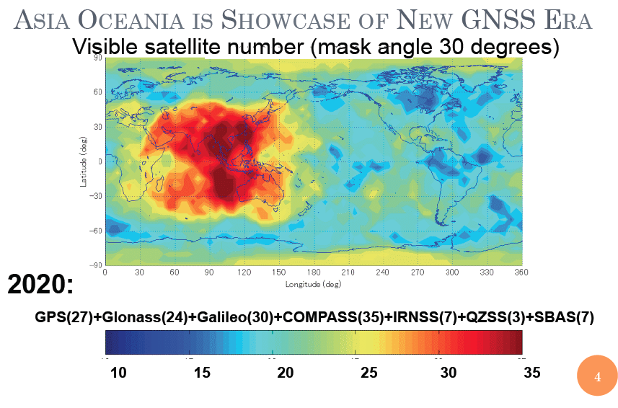
Multi-GNSS: Opportunity for Vietnam
Technology:
Higher accuracy, availability, RELIABILITY
Vietnam
Economy:
Location-based and specialized services develop forcefully
International Cooperation:
Avoid depending on a particular system, consist with current conditions of Vietnam

Slide 38
Conclusions
Among space technologies, satellite navigation becomes more and more important to the human society in many aspects
South-East Asia (including Vietnam) is covered by the largest number of systems (GNSSes + RNSSes) ➔ interesting region for GNSS research and applications
Multi-GNSS environment increases: availability, reliability and accuracy of the navigation services ➔ unquestionable opportunities for Vietnam but many challenges for full exploitation its benefits
International cooperation, especially with the countries mastering this technology, is very important for the development of satellite navigation in Vietnam
NAVIS Centre at HUST has strong expertise, good international relationships with key players, and increasing reputation in the field of GNSS
NAVIS Centre would like to cooperate with the Government agencies, research organizations, universities, and enterprises, … for the development of satellite navigation in Vietnam, and in the region as well.

Slide 39




Thank you very much for your attention!
NAVIS Centre at HUST
NAVIS
Centre
http://navis.hust.edu.vn

